Slide 1


Decoding Manchester Coded Transmissions in Hardware
Zachary Kohnen
z.j.kohnen@student.tue.nl
Alex Alvarado
a.alvarado@tue.nl
Information and Communication Theory Lab,
Signal Processing Systems Group,
Department of Electrical Engineering,
Eindhoven University of Technology, The Netherlands
www.sps.tue.nl/ictlab/
Where innovation starts
Notes:
[skip if said before] Hello, I am Zach, an Electrical Engineering student at Eindhoven University Technology in the Netherlands.

Slide 2
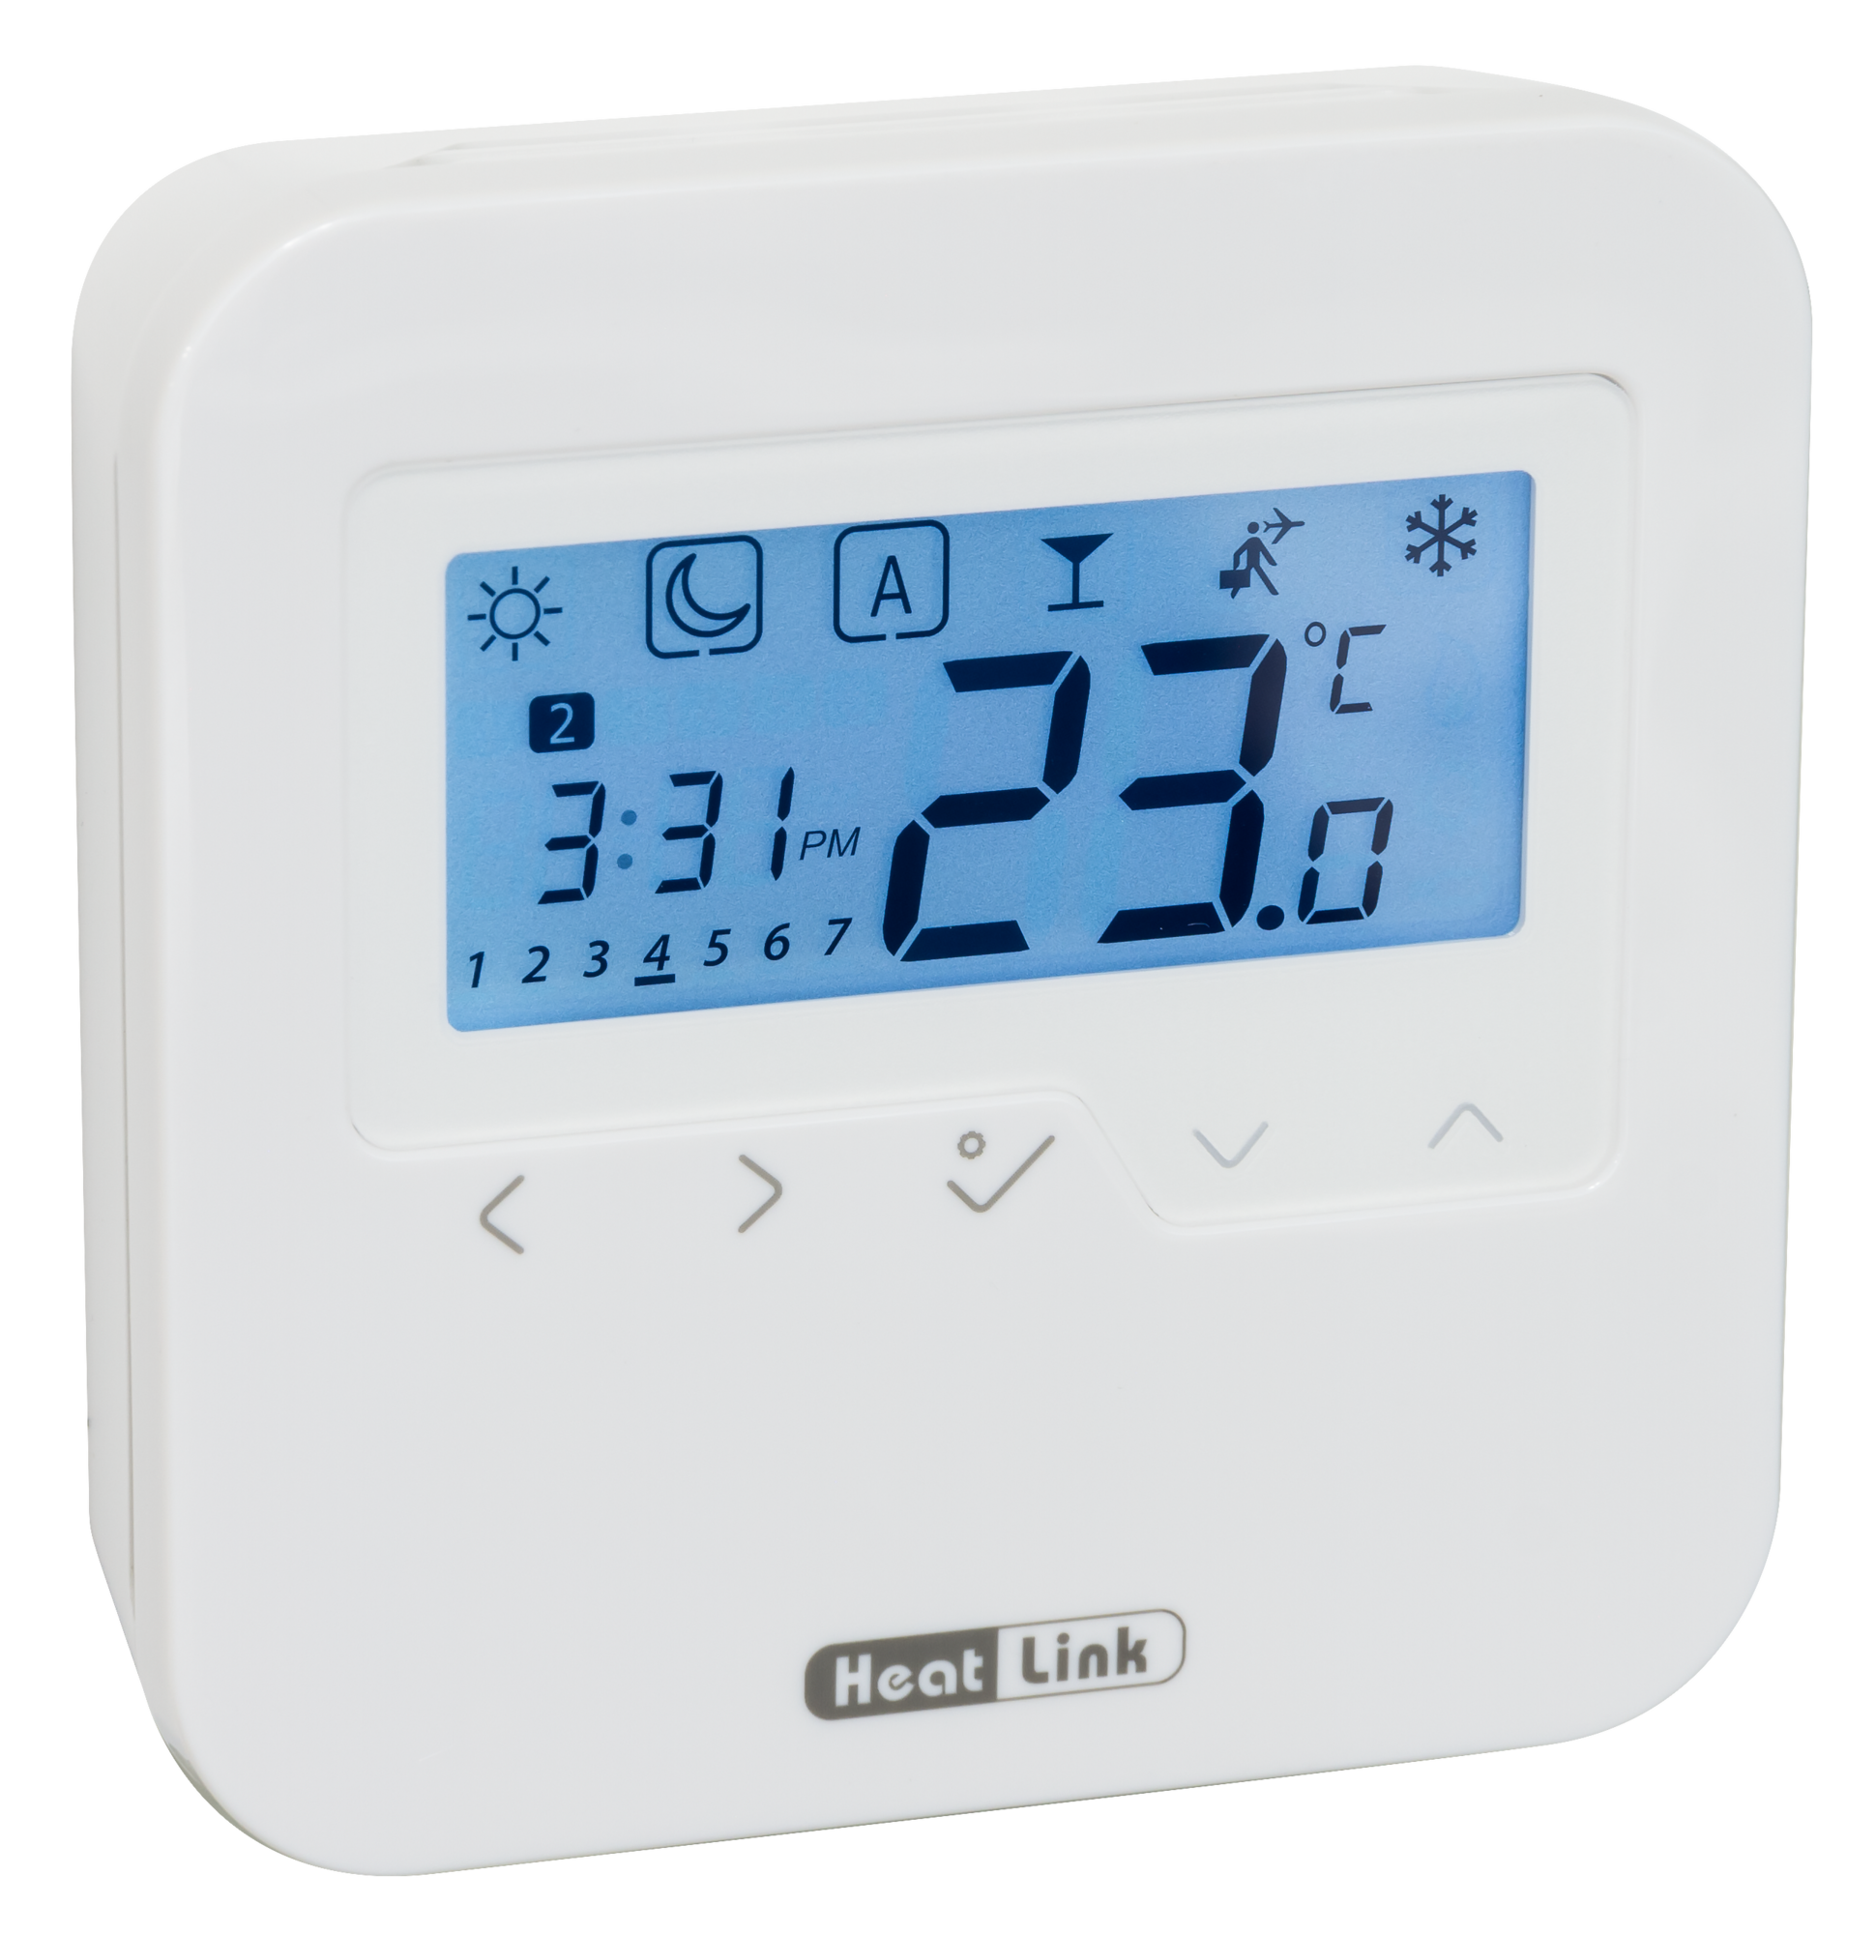
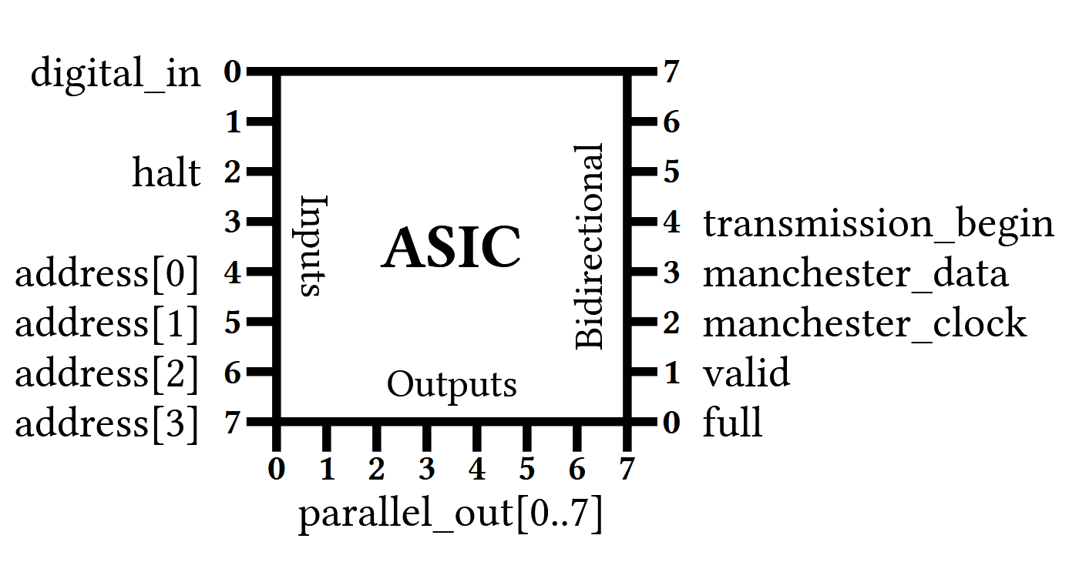
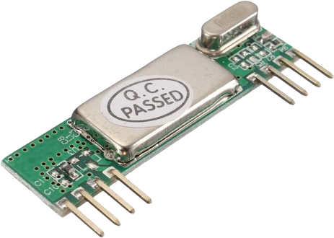

The Project
Decoding Manchester-coded data from cheap devices like thermostats.
Goal: Demonstrate an ASIC-based solution using TinyTapeout.
Designed and simulated in 16 weeks (1 semester)
Room Temp: 23.0°
Set Temp: 18.0°
Notes:
Last year, for my Bachelor’s graduation project, The goal was to use TinyTapout to create a decoder for Manchester coded signals from a wireless thermostat.
I had heard about the TinyTapout project and was excited for the opportunity to design my own piece of silicon. Coming from a more embedded-systems and programming background, I never thought I would have been able to produce my own chip.
The final project had a timeline of 16 weeks, including background research, and development.
--- Breathe
The thermostat will transmit its measured and set temperature at regular intervals.
To keep the design on the chip simple, it was decided to use a low-cost off-the-shelf receiver.
This would demodulate the signal from the thermostat and provide the underlying digital signal to my design, which will then be responsible for handling the Manchester coding, detecting the incoming frames, and extracting the payload from them.

Slide 3
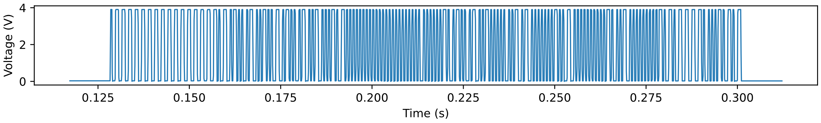
Manchester Coding
Notes:
At the top of the screen, we can see a transmitted frame from the thermostat, captured by the receiver. The data has been encoded with Manchester coding.

Slide 4
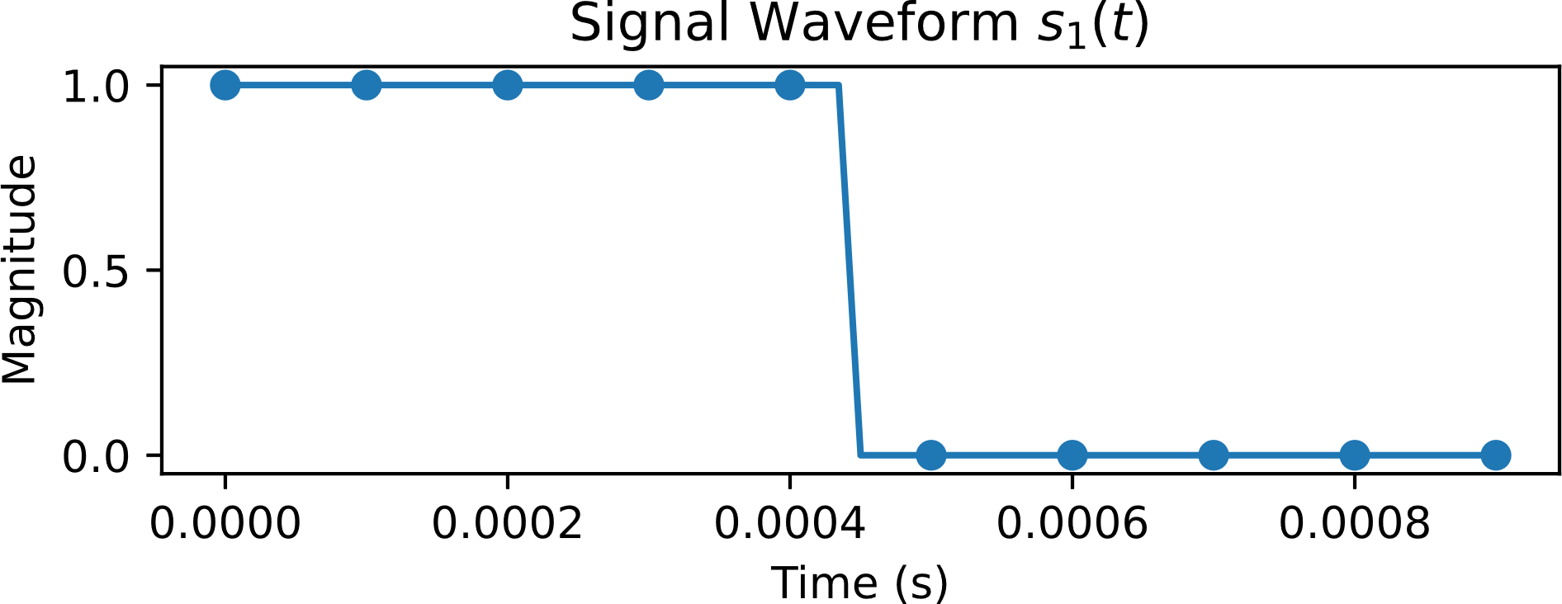
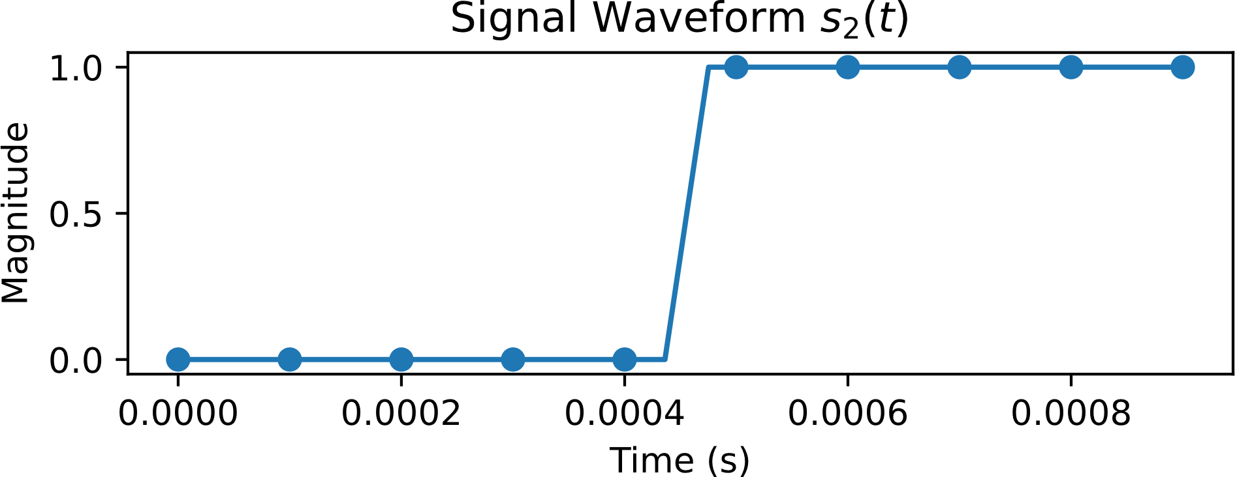
Manchester Coding
Notes:
Manchester coding uses two symbols, a falling symbol and rising symbol. Each symbol contains a data-carrying edge. Since the encoded signal sent by the thermostat has quite a low frequency (1kHz), oversampling the incoming data at 20kHz was chosen to remove the need for complicated clock disciplining or the need for a PLL.

Slide 5
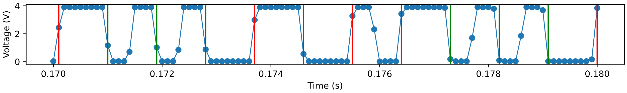
Manchester Coding
Notes:
Although there is only one data-carrying edge per symbol, placing the same symbol back-to-back will result in 3 edges which can be seen at the bottom. Only the colored lines represent data-carrying level transitions, but there are 5 other edges in this snapshot.

Slide 6
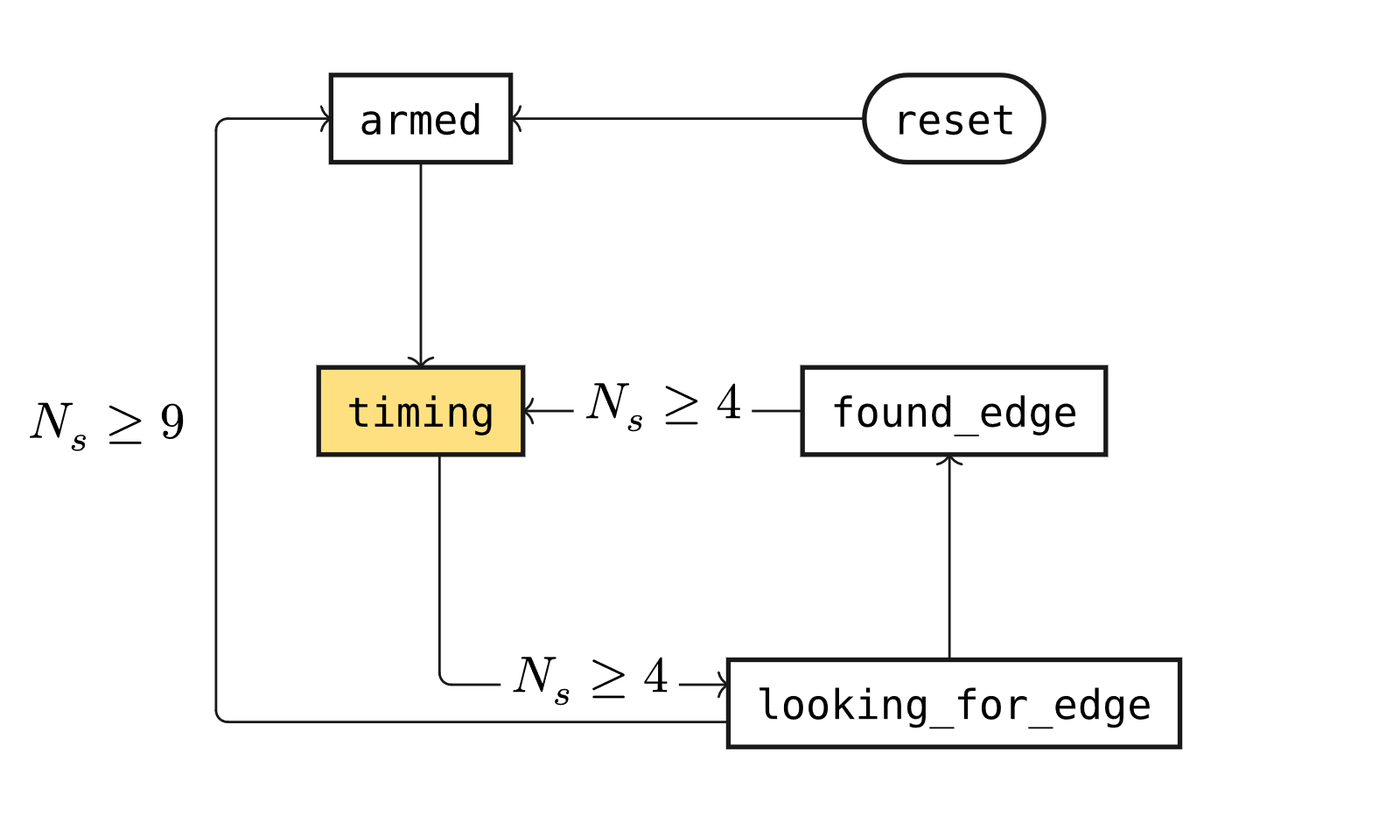
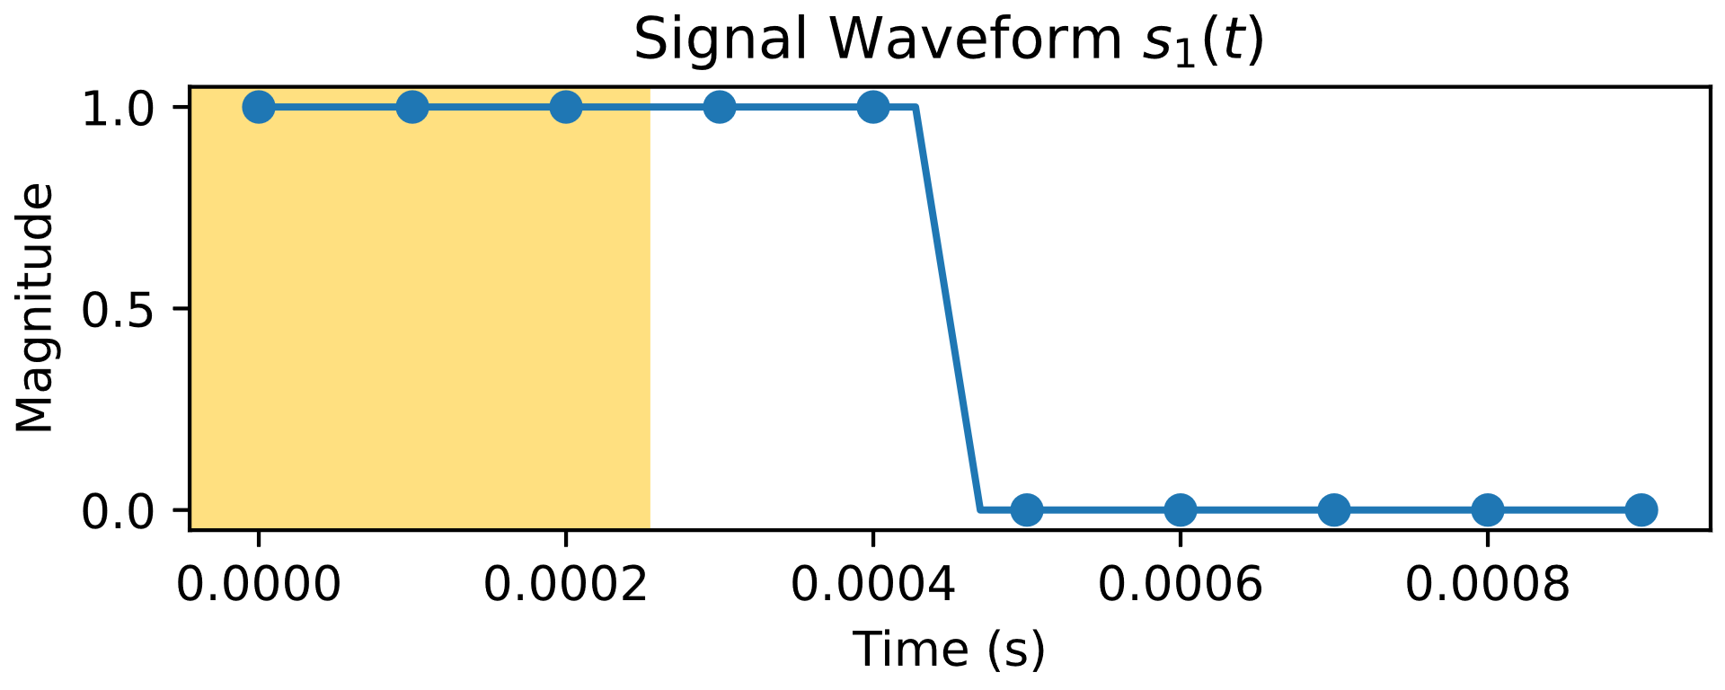
Decoder State Machine
Notes:
It is the job of the state machine to detect each edge and filter just the data-carrying ones.
This was implemented with a timer-based approach. This was chosen to simplify the logic required, only utilizing a timer and a state machine.
The state machine will wait for the first quarter of the samples to be received (in yellow).

Slide 7
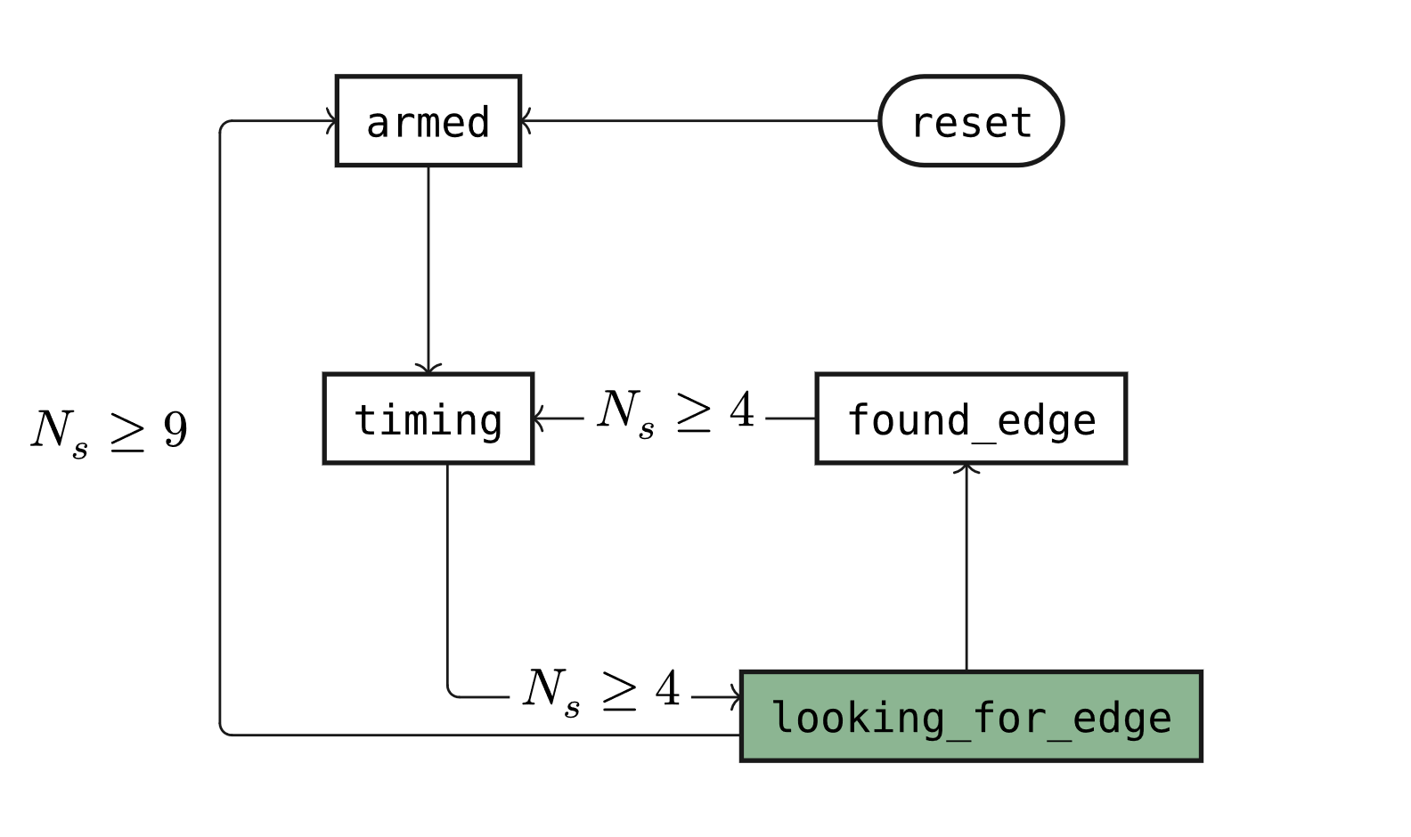
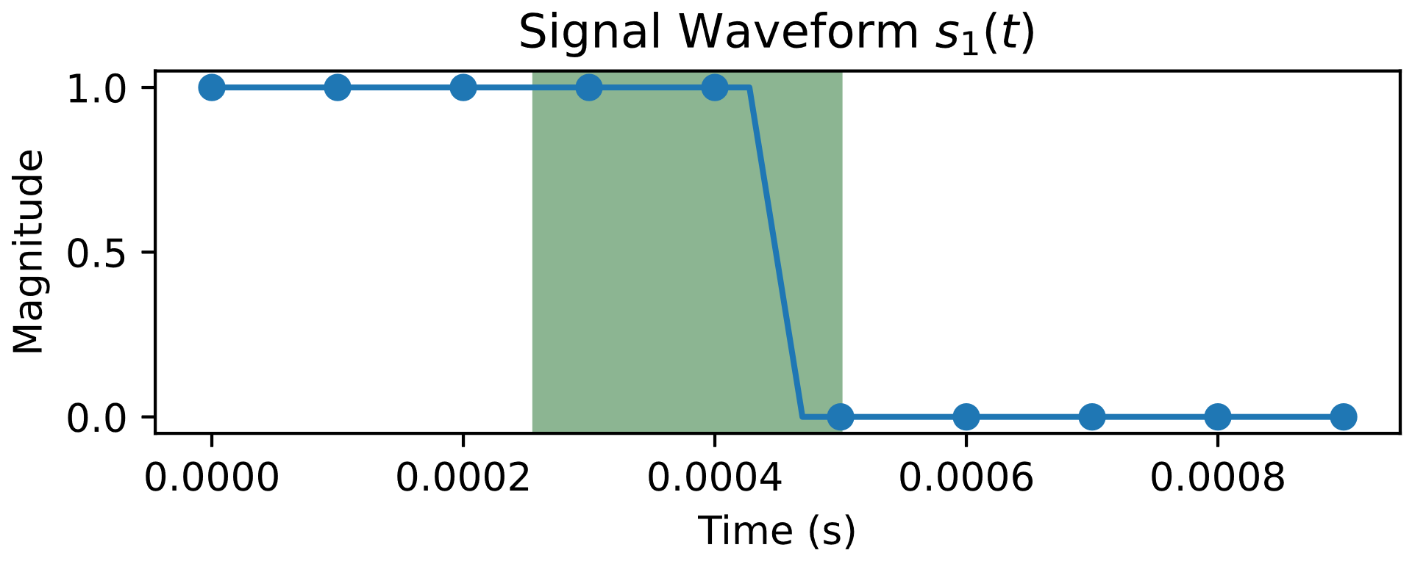
Decoder State Machine
Notes:
Then the state machine will wait for a positive or negative edge (in green).

Slide 8
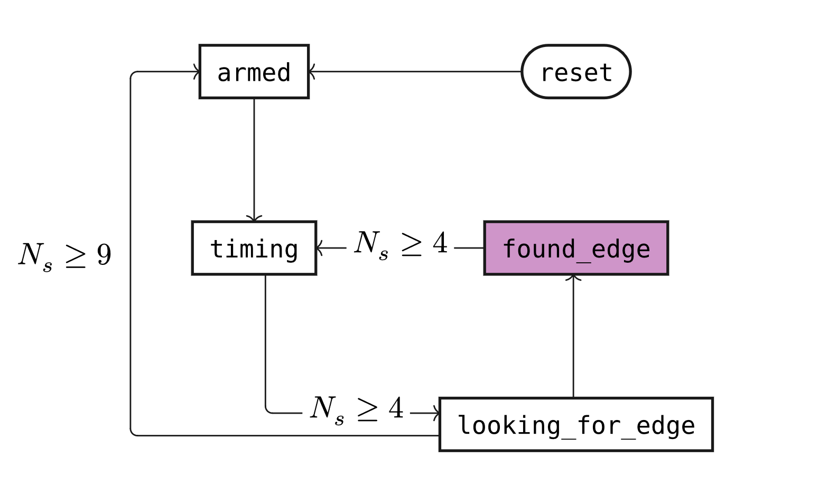
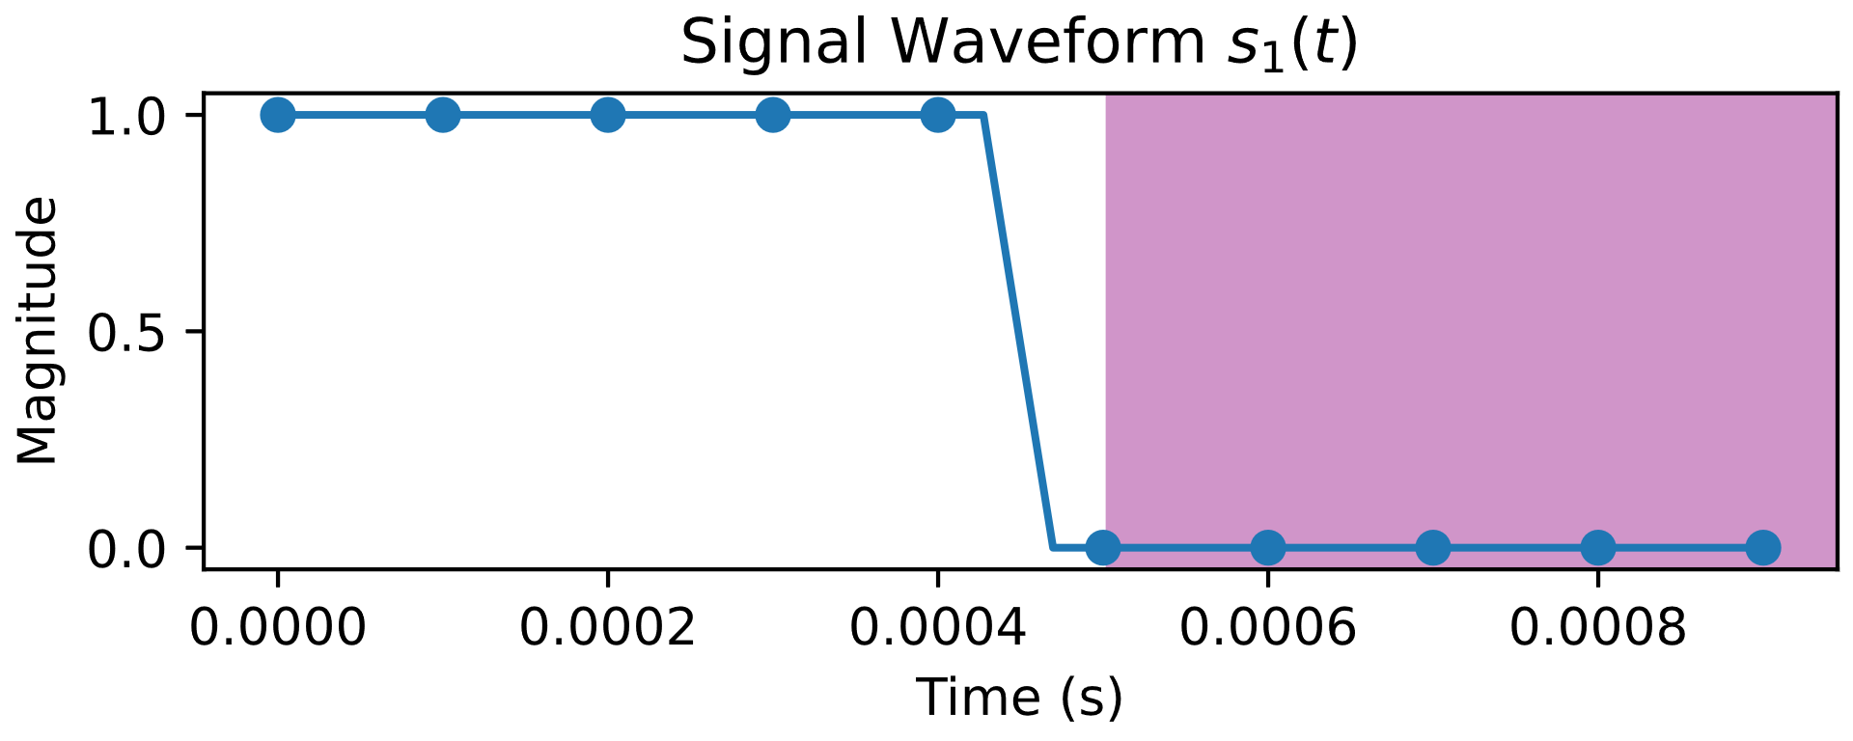
Decoder State Machine
Notes:
Once an edge has been detected, the state machine will send out the Manchester clock signal, and the symbol value.
The state machine will then wait for the remaining samples (in purple).
This loop will repeat until an edge is not found for 9 samples, which represents the end of the transmission.

Slide 9
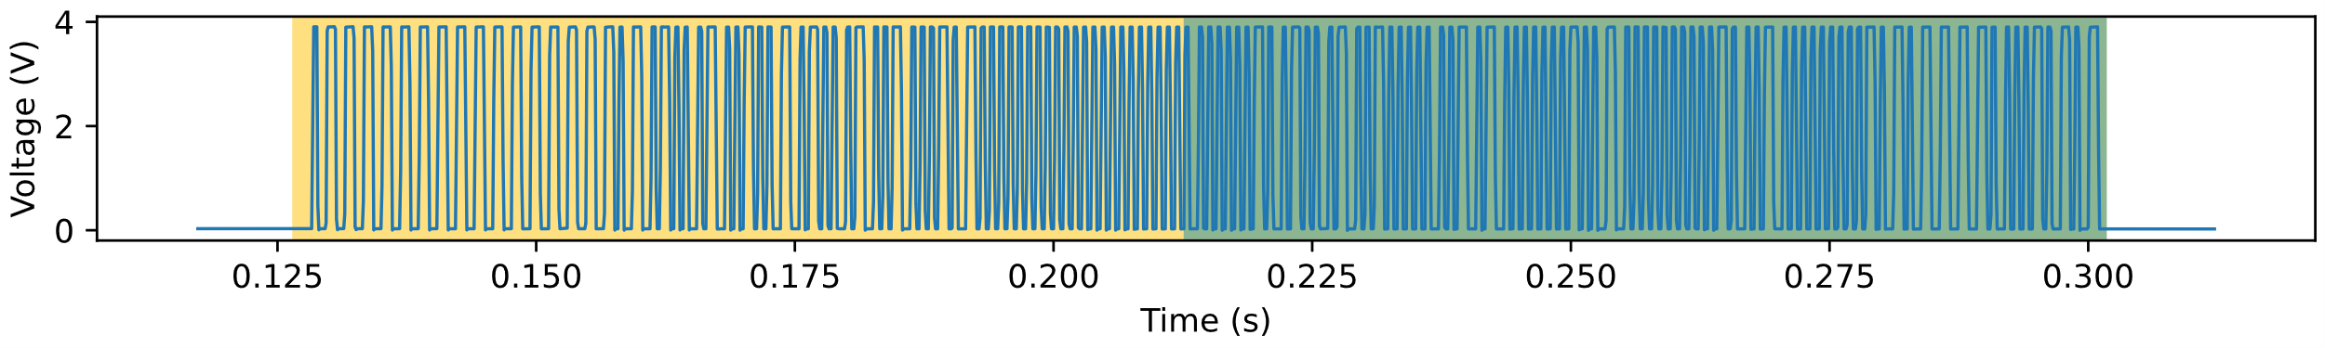
Data Frame
Preamble: Same for each transmission
Data: Variable, containing the interesting fields
Notes:
Looking back at the frame sent by the thermostat, it can be broken in half into two sections, a preamble which is constant between transmissions, and a data section which contains the variable data.
Since the preamble does not contain useful data, it does not need to be stored.
The preamble and data sections can share the same shift buffer.
The shift buffer will first be filled with the preamble, which will be verified to ensure synchronization, then the shift register will continue to shift in the next 96 bits containing the frame’s data.

Slide 10
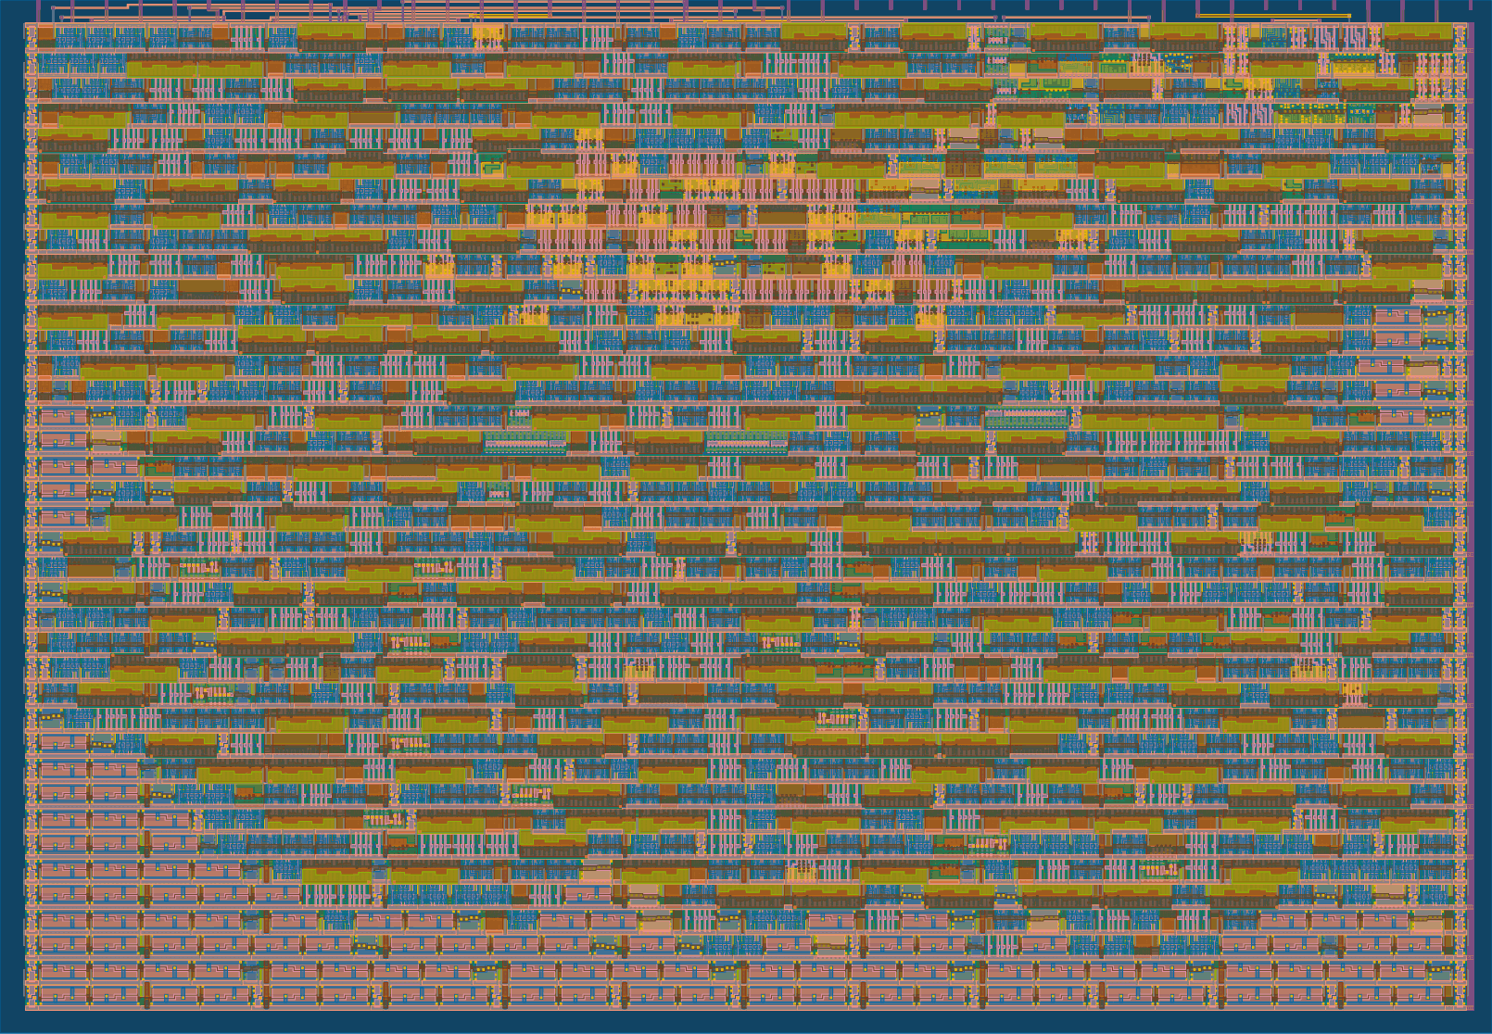

Optimization
Support from TinyTapeout Discord community
ASIC fits within a single tile
Notes:
Sharing one register between the preamble and the data sections helped to decrease the utilization of the design to be able to fit within one TinyTapeout tile, which you can see a rendering of on the right.
The TinyTapeout discord community was a great help regarding optimization, especially for a beginner like me.

Slide 11
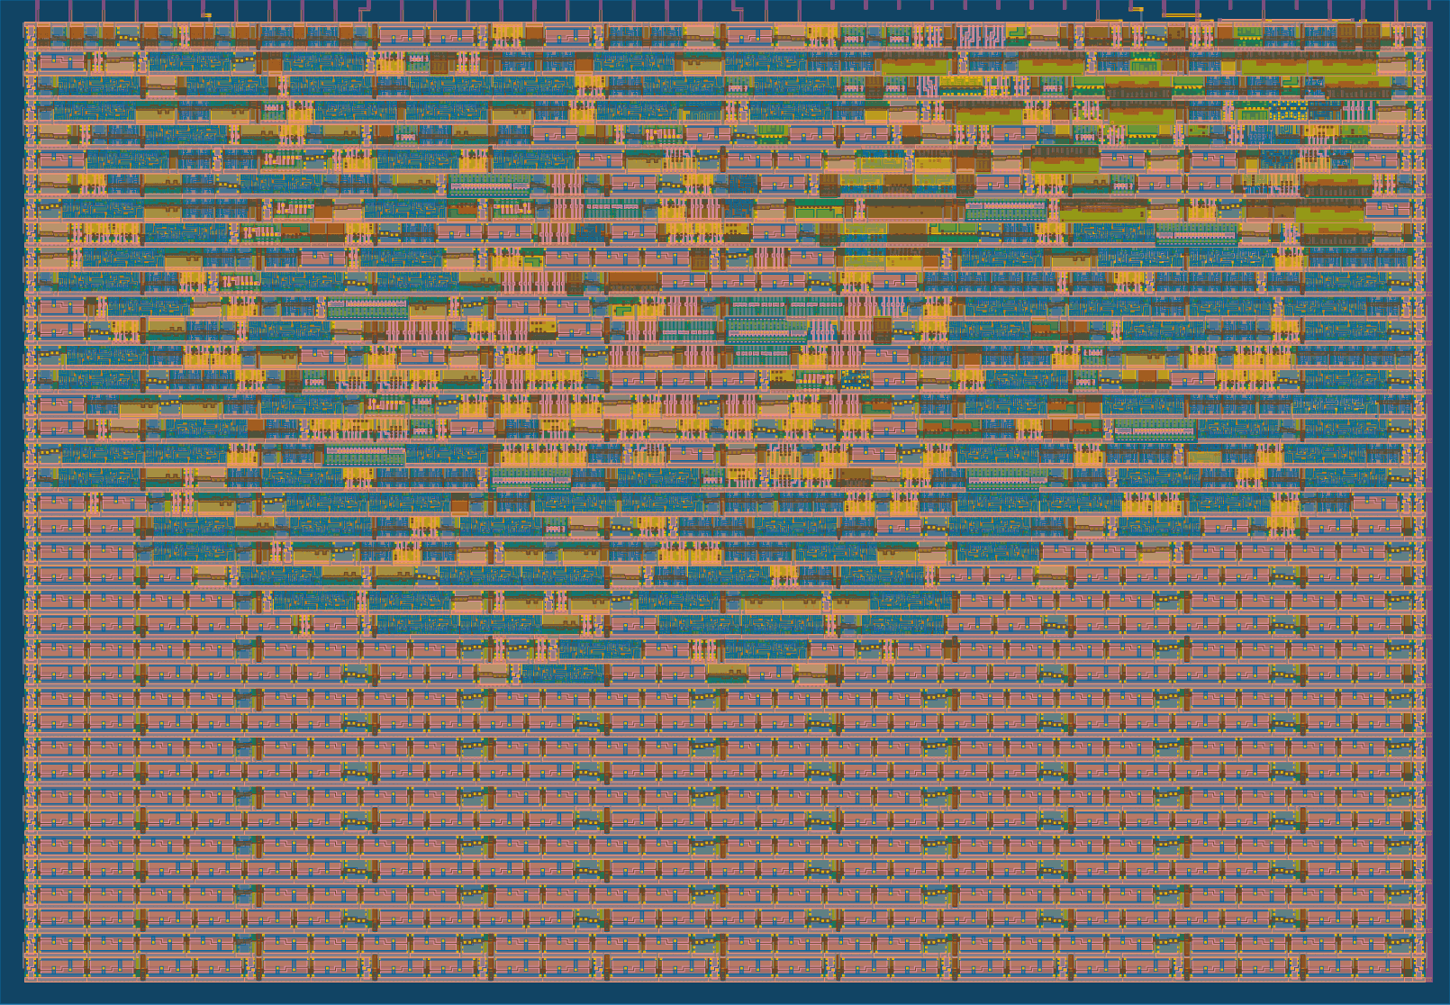
Optimization
Support from TinyTapeout Discord community
ASIC fits within a single tile
Optimized further from 62% to 32% utilization.
Notes:
There were a few other design changes that were implemented to reduce the footprint of the ASIC design which an FPGA design would not have to worry itself with, and with these I was able to reduce the footprint further from 62% to 32%.

Slide 12
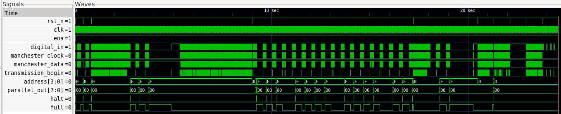
Simulation Testing
Transmissions from the thermostat were captured with the RXB6
  Replayed into Verilog simulations
Notes:
While developing the Verilog, it was very important to have testing setup to verify the design
Transmissions were captured from the thermostat using the RXB6 receiver. These were then replayed in the test bench to validate the behavior of the design. Testing against this real-world data was important to ensure that the design could be tested in as close to the final setup as possible.

Slide 13
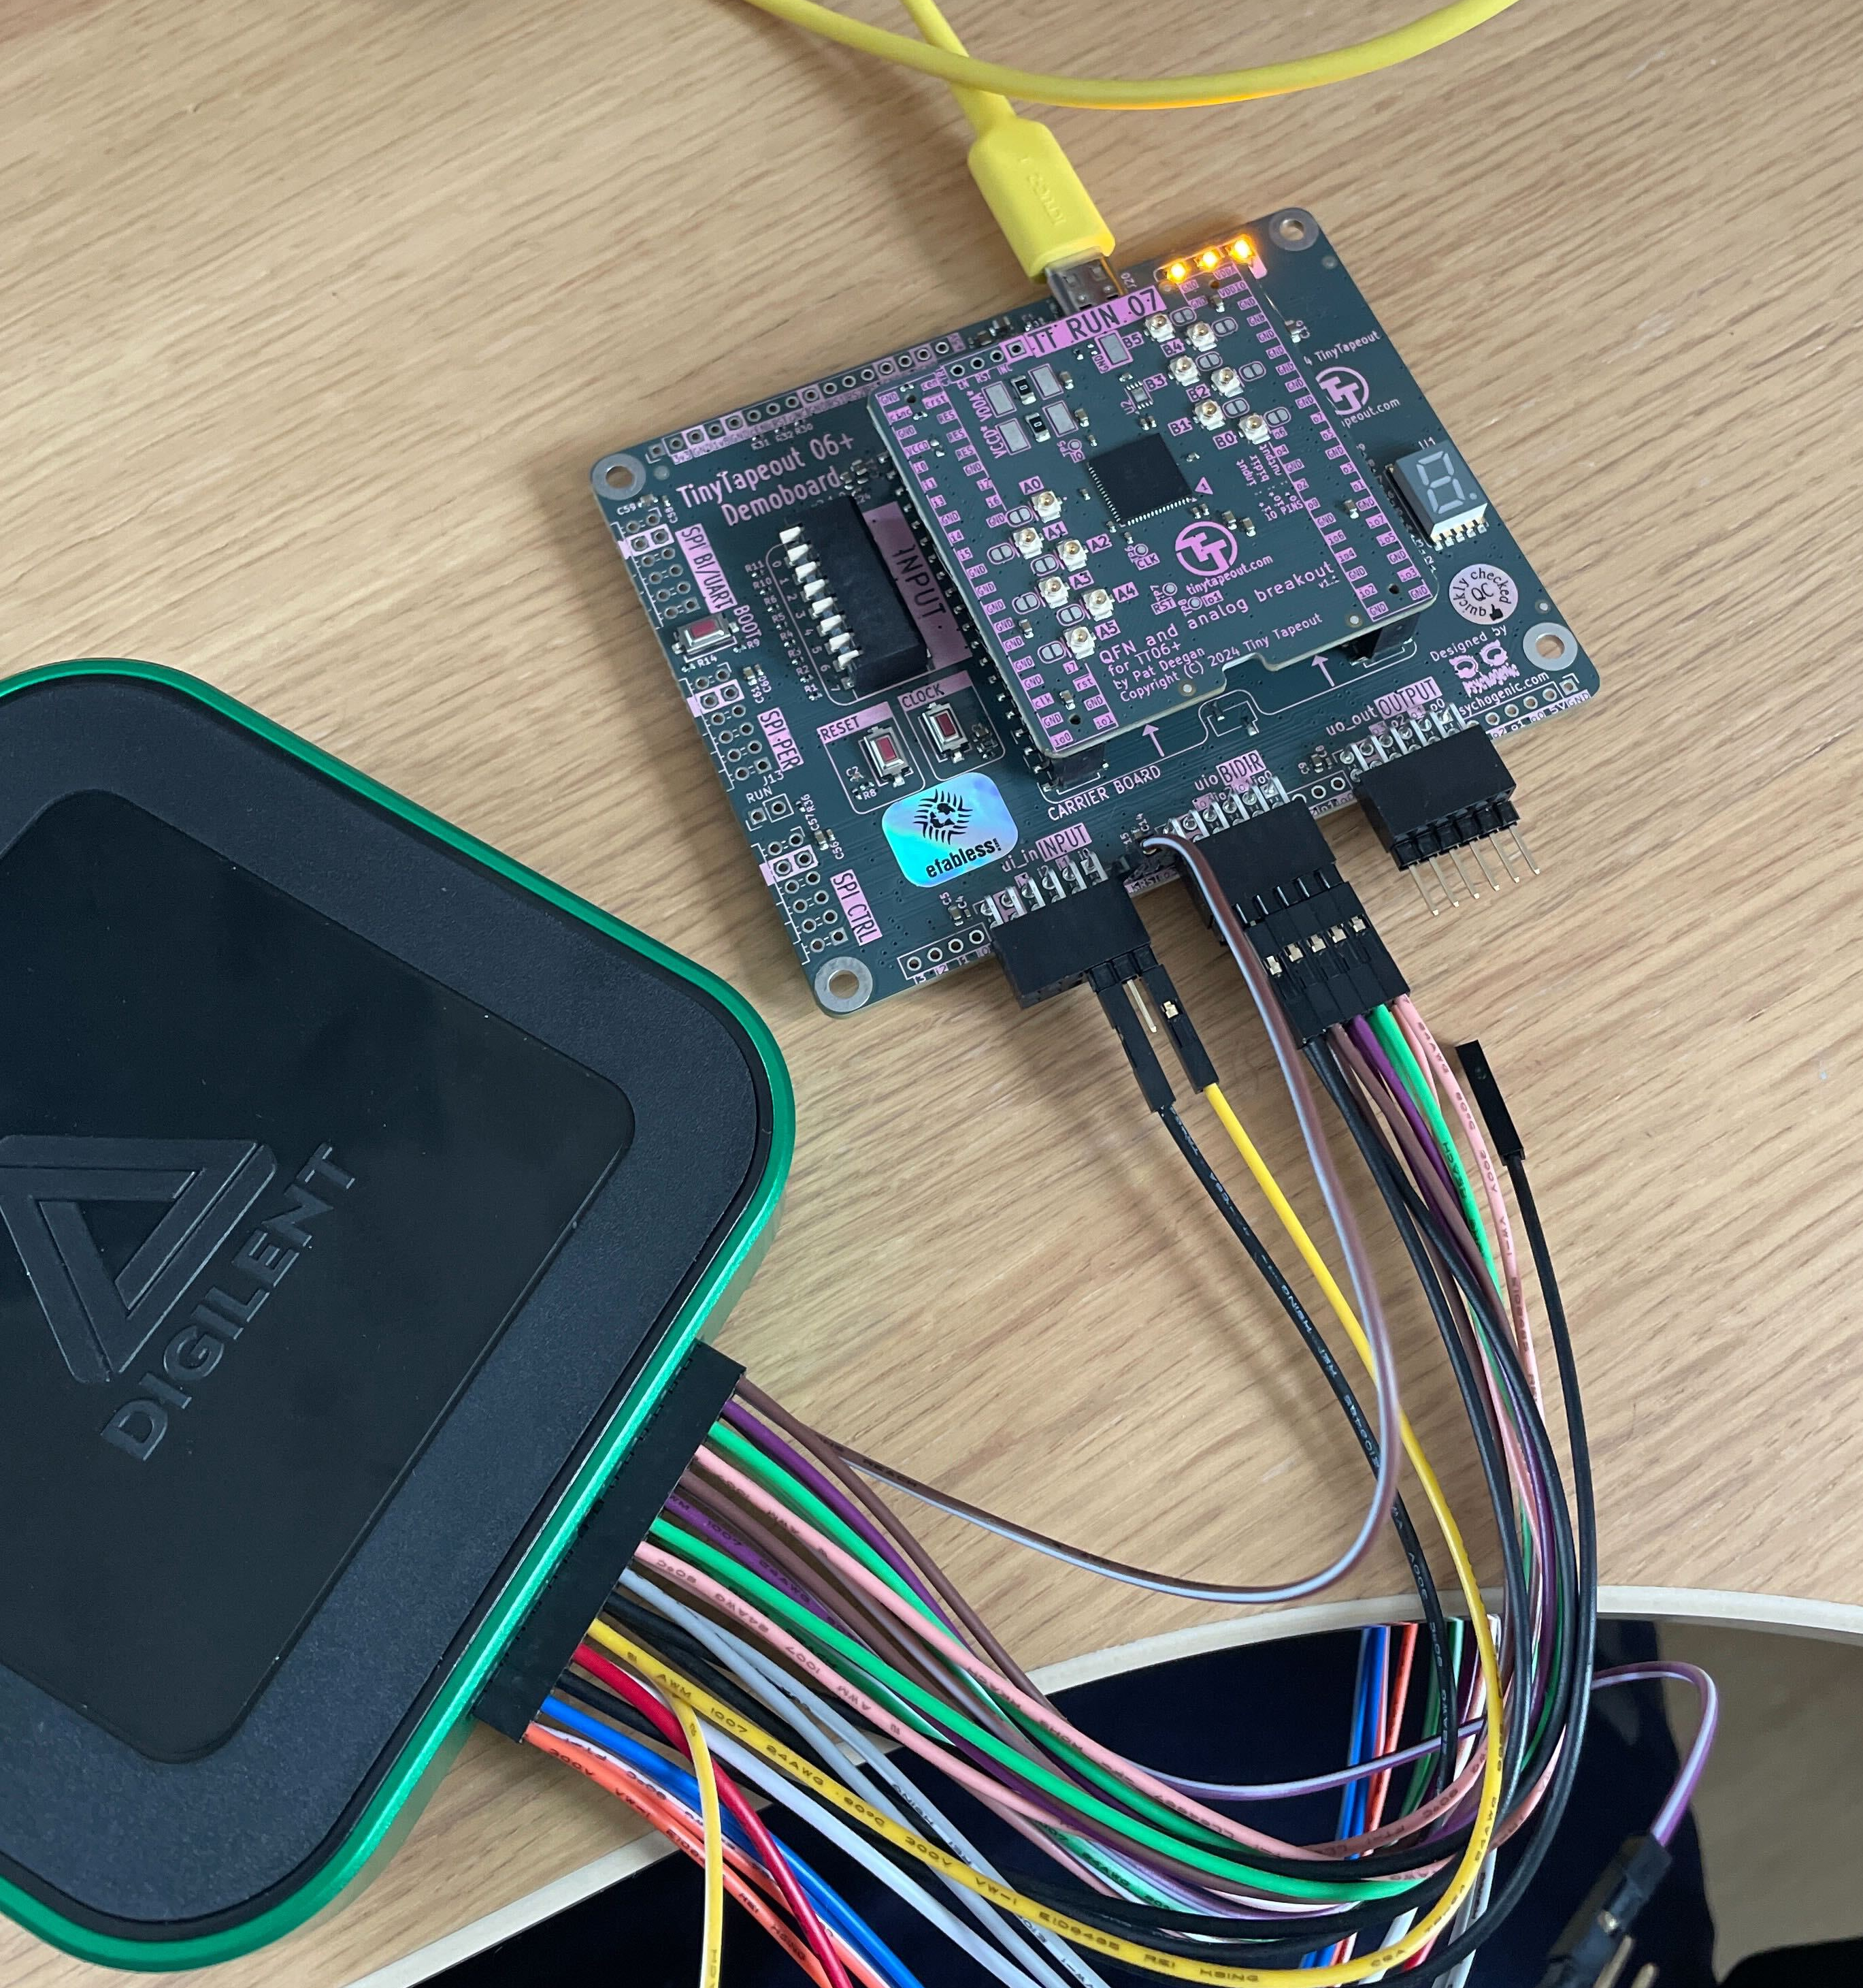
Simulation Testing
Transmissions from the thermostat were captured with the RXB6
  Replayed into Verilog simulations
Real World Testing
Tested with a logic analyzer and the onboard RP2040 microcontroller
  Replayed captured signals
Notes:
I tested the design using a logic analyzer and the onboard microcontroller.
The microcontroller was programmed to be able to readout the data on the chip, as well as to perform reset and clocking for the ASIC

Slide 14
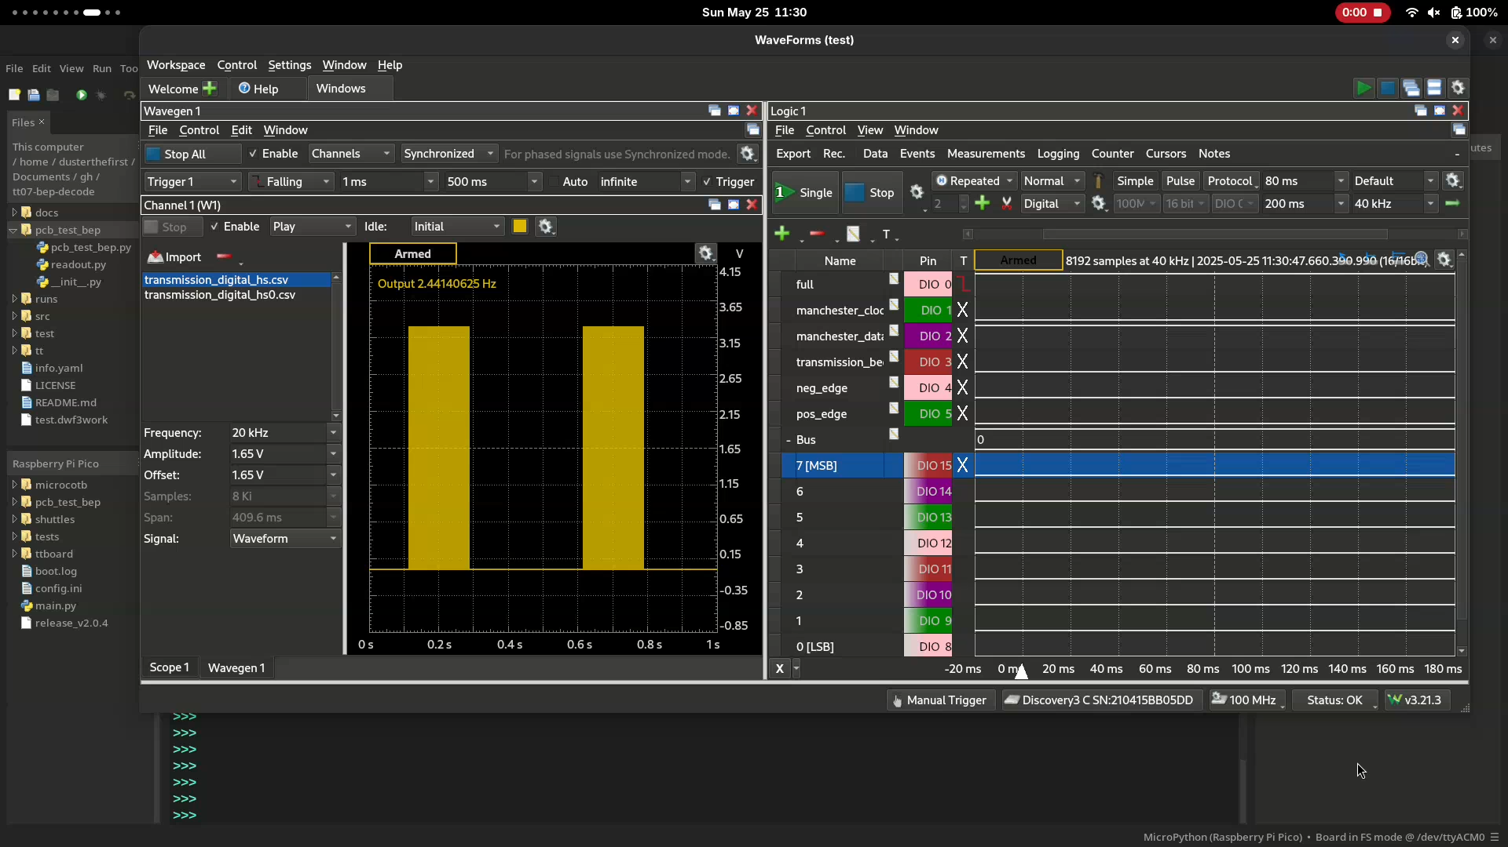
Waveform Generator
Output Signals
RP2040 Python REPL
Notes:
Now I will show a quick demo of a message being sent to the chip from the logic analyzer’s waveform generator.
On the screen here are three main things.
On the left is the waveform generator containing a previously recorded transmission.
On the right are the output signals of the ASIC.
And on the bottom is a “command line” where I can execute code on the microcontroller
I will run the start function, which will cause the waveform generator to send a frame.

Slide 15
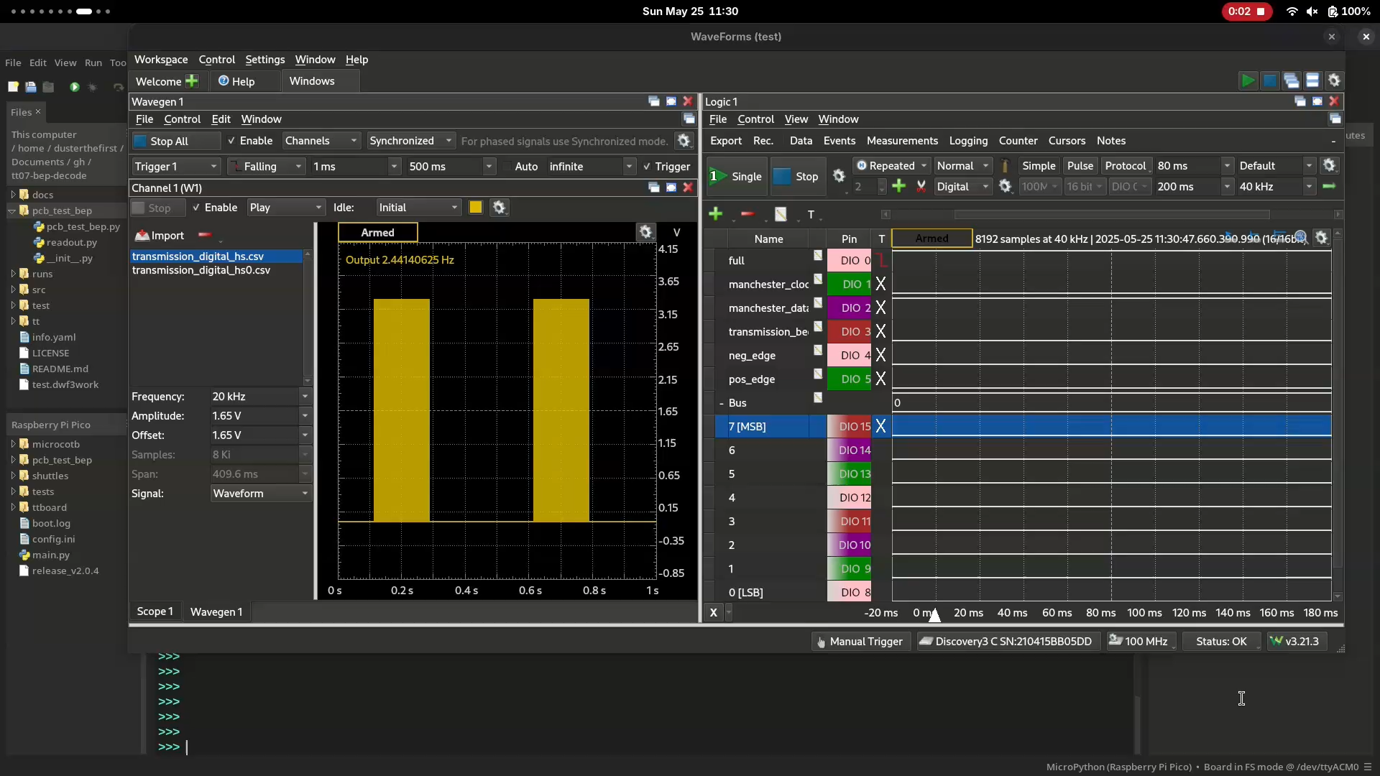
Notes:
On the right, you can see the signals from the ASIC.
From the full signal at the top, we can see that the frame has been captured, and we can now readout the data that was captured.

Slide 16
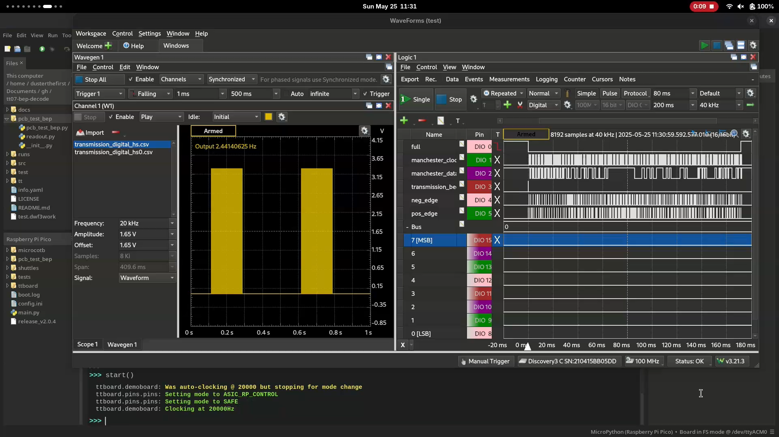
Notes:
On the console in the bottom, we can see the fields that were captured.
Looking at the room and set temperature, we can see values of 24.9 and 18.1.
You'll have to trust me but those are the values in the transmission.

Slide 17
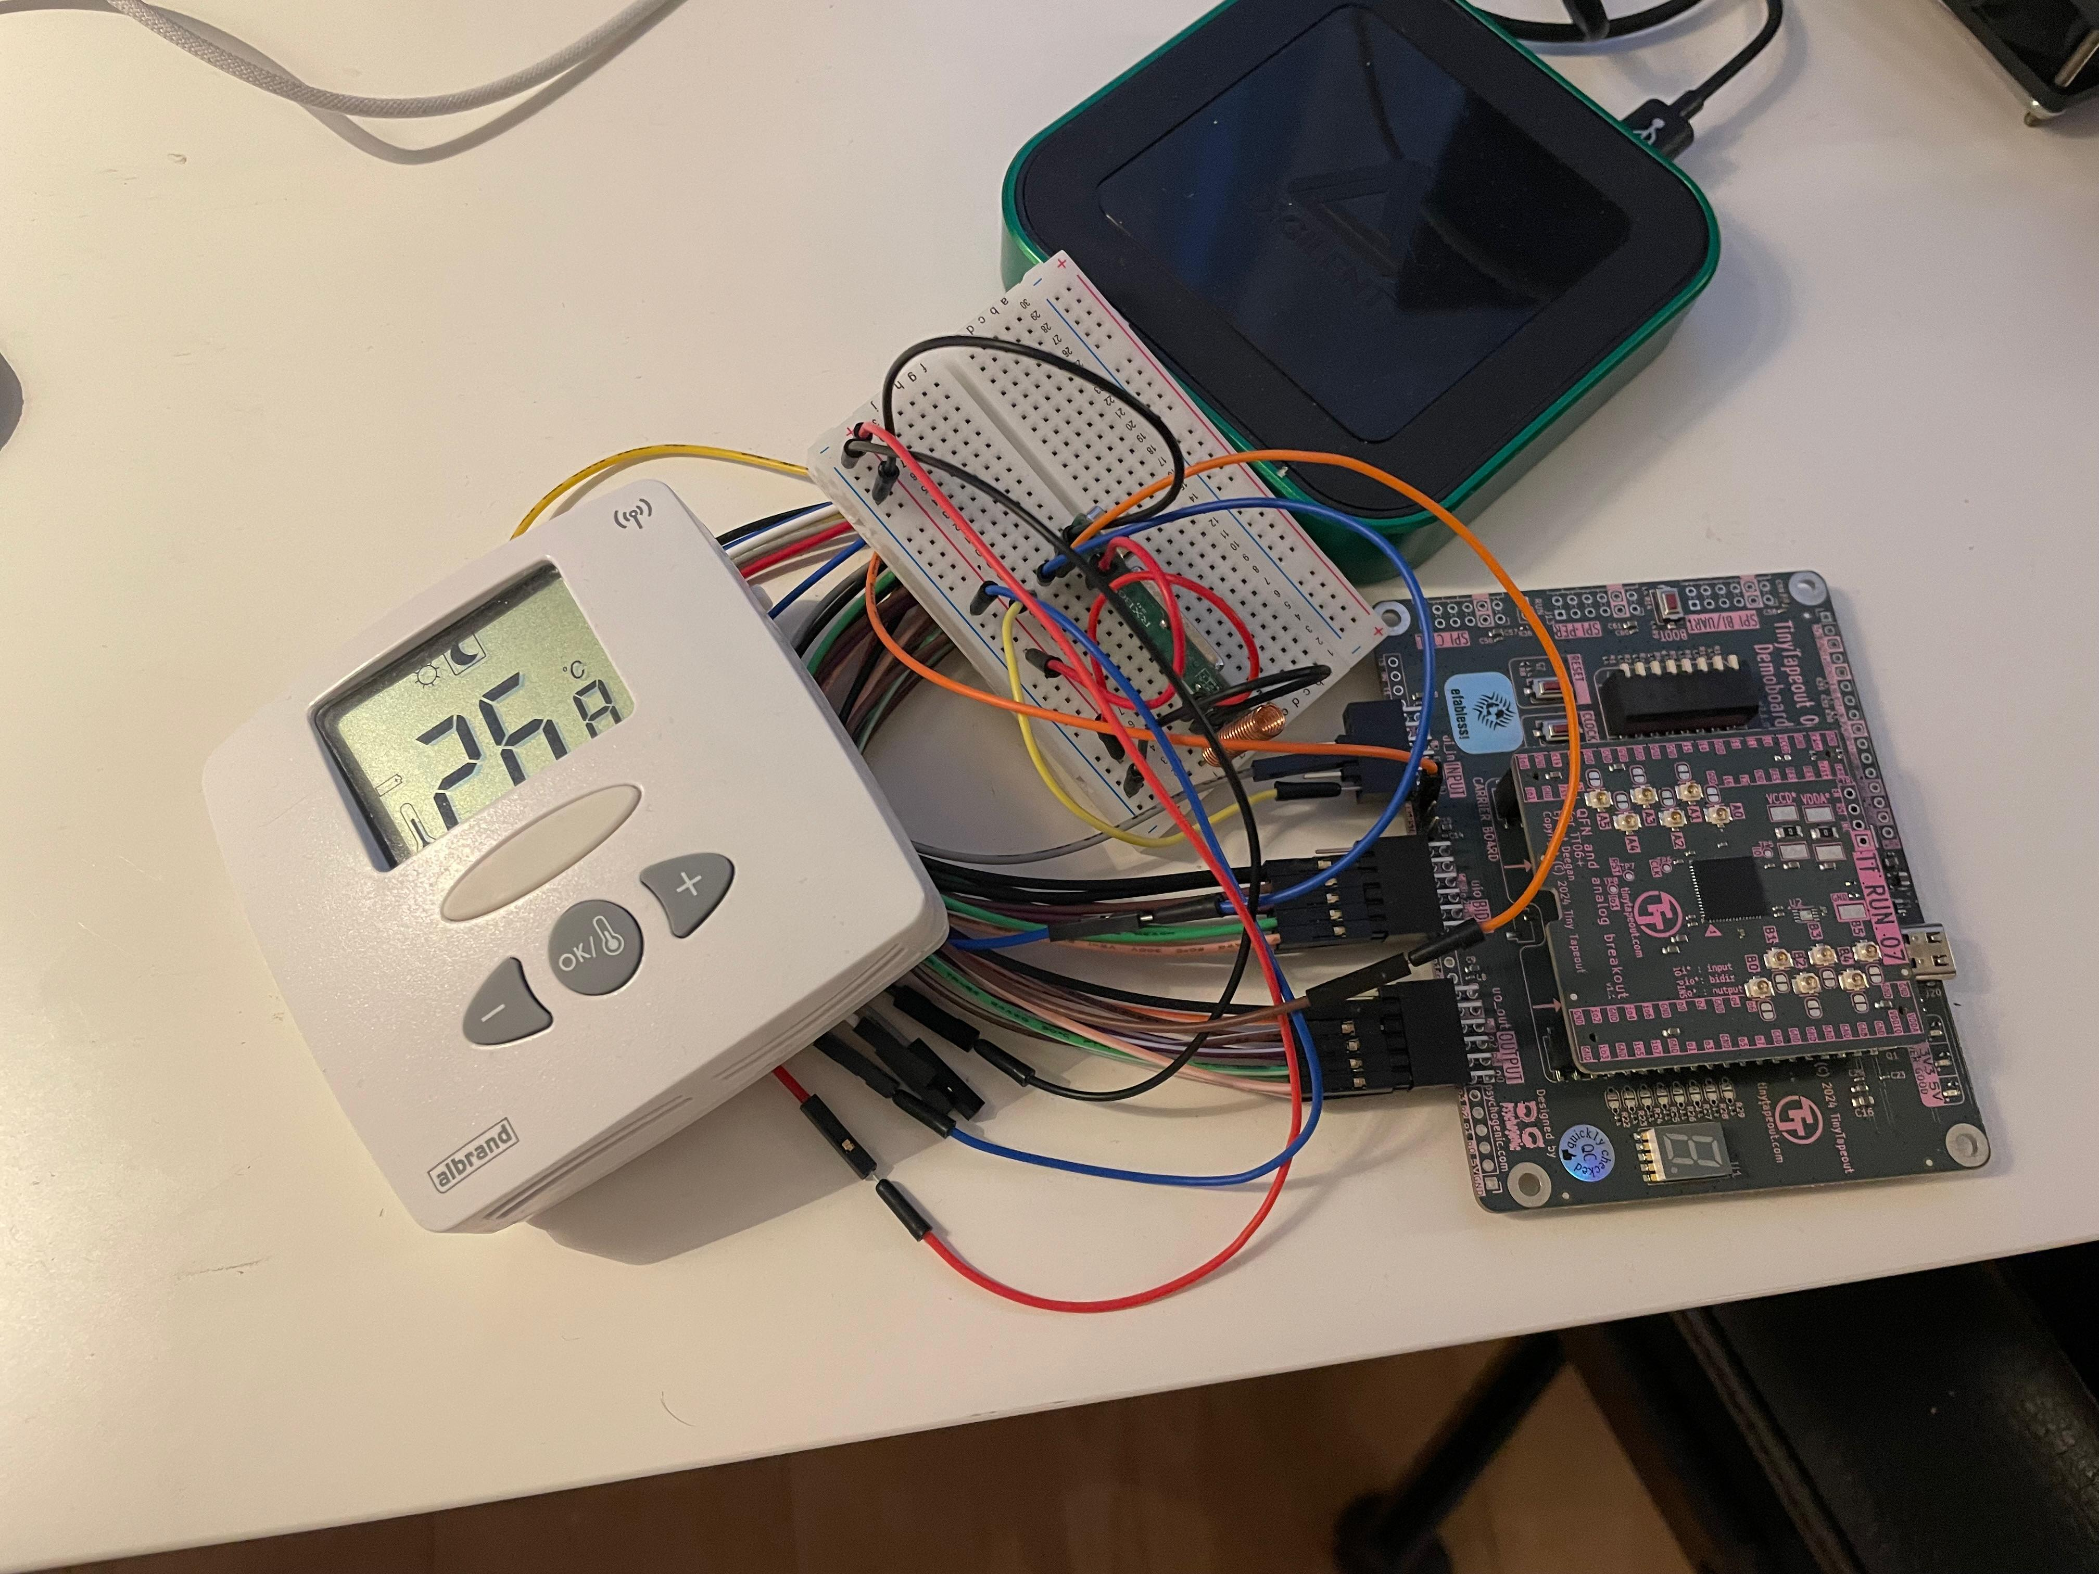
Current Work
Real-time testing with the RXB6
Live display of the thermostat’s data
Takeway
Testing designs in simulation is important
ASICs are accessible, even to those with no prior experience.
https://github.com/DusterTheFirst/tt07-bep-decode
Notes:
Testing using a recorded transmission worked great, and I am currently working on testing the system with the receiver and thermostat directly. In the end it should be able to capture and display the measured thermostat data.
Overall, with the project I was extremely satisfied with the tooling provided by TinyTapout, the community support around it, and just what I was able to accomplish.
I was able to learn a lot about the ASIC development process in a hands-on manner that will really stick with me.

Slide 18
Decoding Manchester Coded Transmissions in Hardware
Zachary Kohnen
z.j.kohnen@student.tue.nl
Alex Alvarado
a.alvarado@tue.nl
Information and Communication Theory Lab,
Signal Processing Systems Group,
Department of Electrical Engineering,
Eindhoven University of Technology, The Netherlands
www.sps.tue.nl/ictlab/
Where innovation starts
Notes:
Thank you

